Slide 1
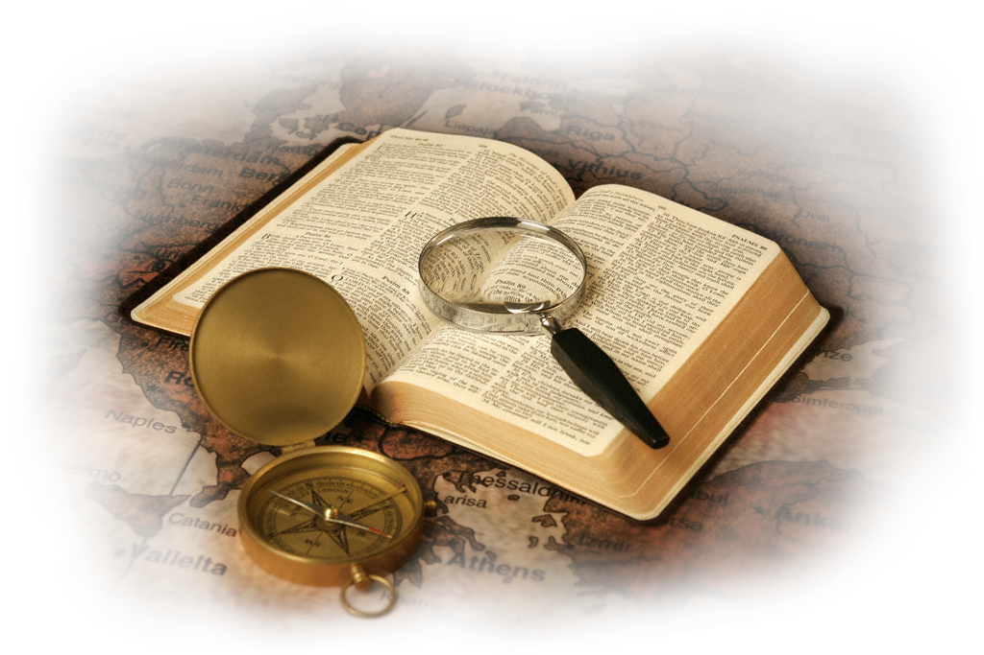

Slide 2
With today’s changing and polarizing societal movements and ideologies such as pro-choice vs. pro-life, LGBTQ+, the ever-expanding definitions of gender identification, women’s “Me Too” rights, Black Lives Matter, racial unease, political divides (Republican v. Democrat; Liberal v. Conservative; Right v. Left), economic uncertainty, border insecurity, climate fears, pandemic hysteria, and an ever-expanding list of nations in turmoil or at war…
What’s a Christian to Do In this Culture?

Slide 3
Acts 17:22-31
δεισιδαιμονεστερους
How to Witness Boldly in this Culture – 1

Slide 4
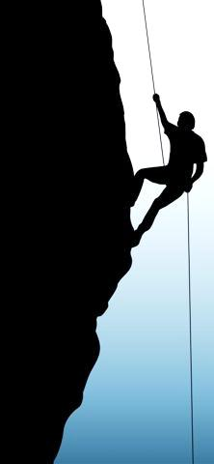
Why study Acts 17?
“The whole book of Acts should receive careful study. It is full of precious instruction; it records experiences in evangelistic work, the teachings of which we need in our work today. This is a wonderful history; it deals with the highest education…”
(Ellen White, 7-A BC, page 275)

Slide 5
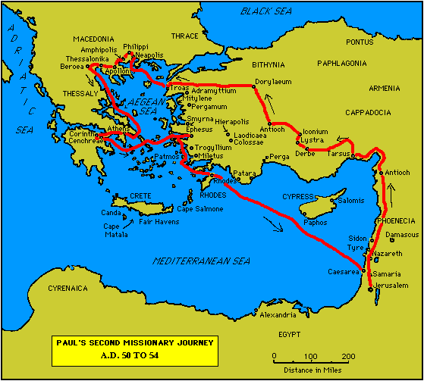
2nd
Missionary
Journey
Acts 15:36 – 18:22

Slide 6
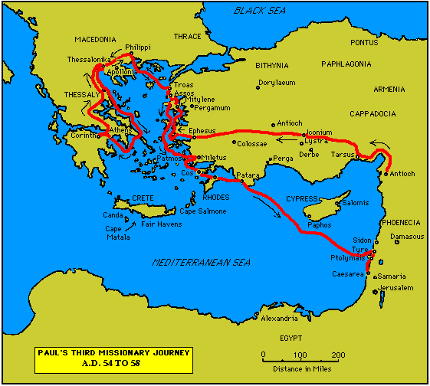
3rd
Missionary
Journey
Acts 18:23 – 21:14

Slide 7
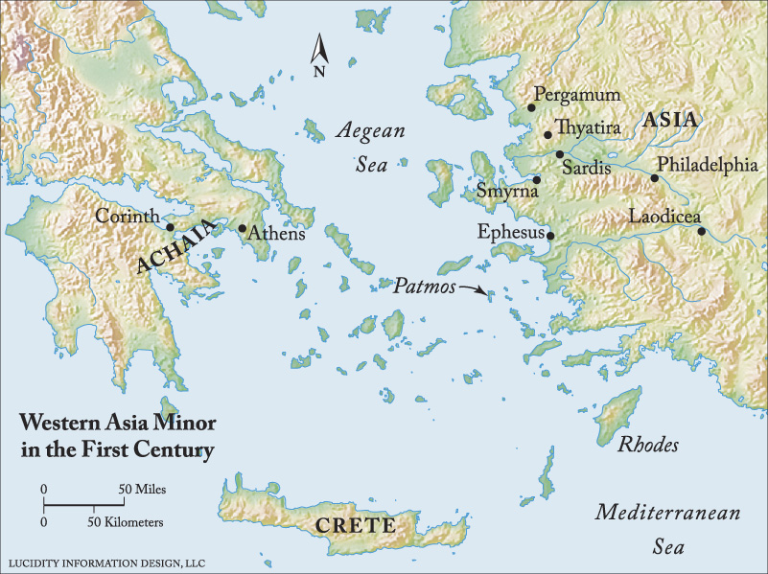

Slide 8
Acts 17:15
Now those who escorted Paul brought him as far as Athens; and receiving a command for Silas and Timothy to come to him as soon as possible, they left.

Slide 9
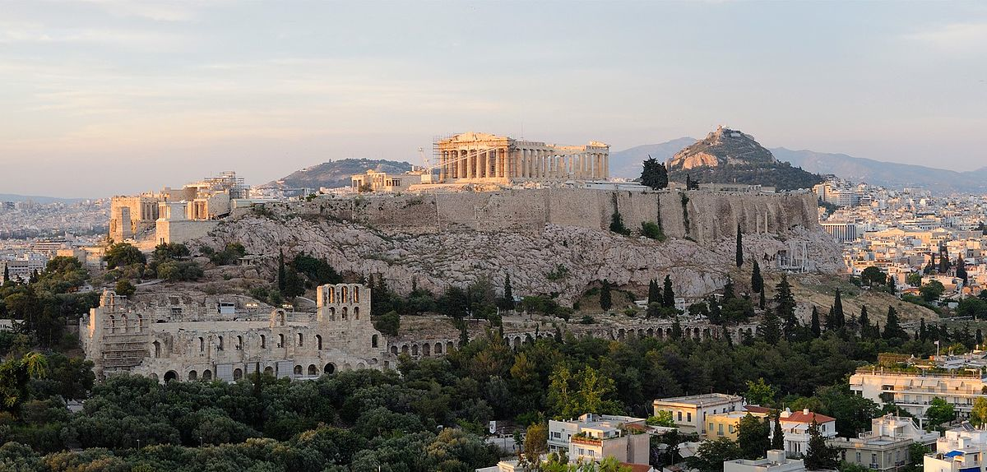
Acropolis
Parthenon of the goddess Athena

Slide 10
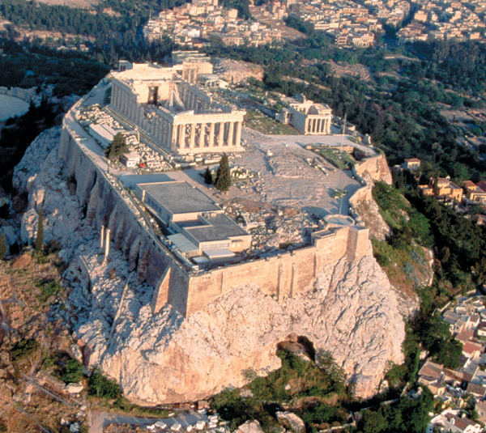
From this southeast photo, the Parthenon and Erechtheum are the most prominent buildings.
Three columns of the eastern facade of the Propylaea (the entrance to the Acropolis) are visible just beyond and to the right of the Parthenon

Slide 11
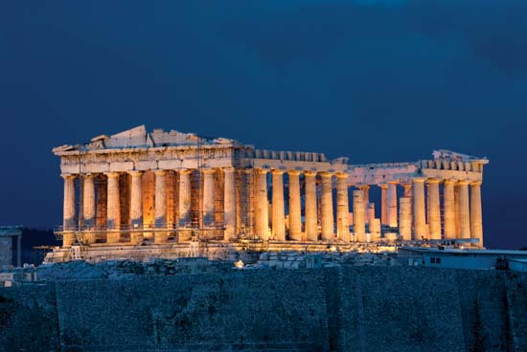
“When the city comes alive with the evening song, we dance in the shadow of the great Pantheon.”
Giannis Georgantelis
“Queen like the Acropolis puts on the sunset’s crimson like a robe.”
Kostas Karyotakis

Slide 12
Athens
“Athens, the eye of Greece, mother of arts and eloquence!” John Milton
“The earth proudly wears the Parthenon as the best gem upon her zone.” Ralph Waldo Emerson
“Made of Athens, ere we part, give oh give me back my heart!” Lord Byron
“Many of our ideas of democracy, so much of our literature and philosophy and science can be traced back to roots right here in Athens.” Barack Obama

Slide 13
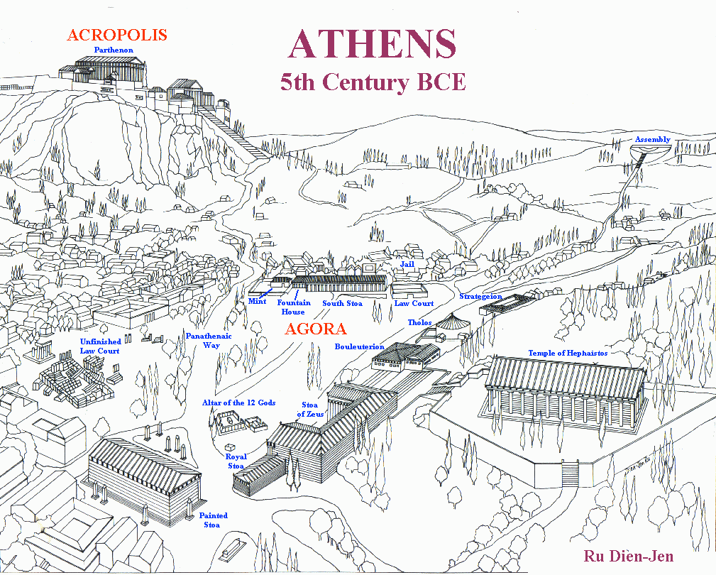
The Agora

Slide 14
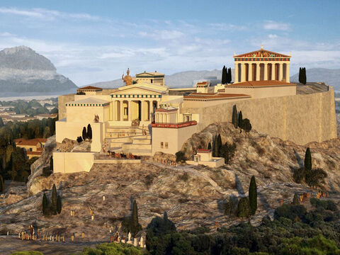

Slide 15
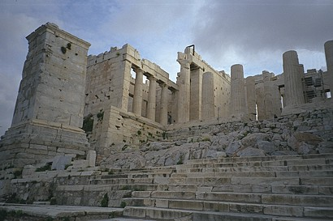
Entering the Acropolis

Slide 16
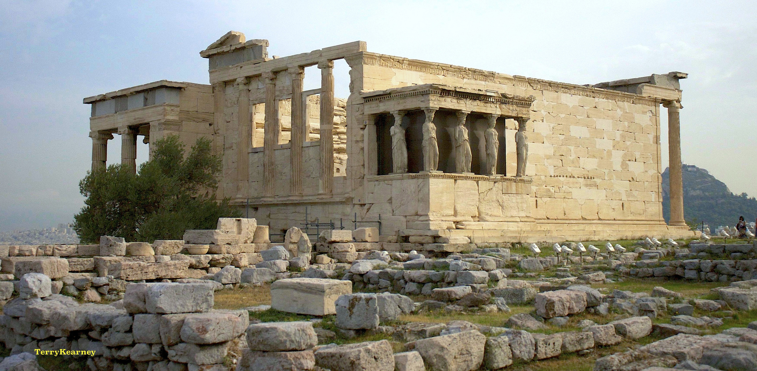
The Erechtheion

Slide 17
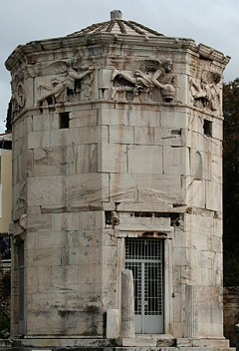
Tower of the Winds

Slide 18
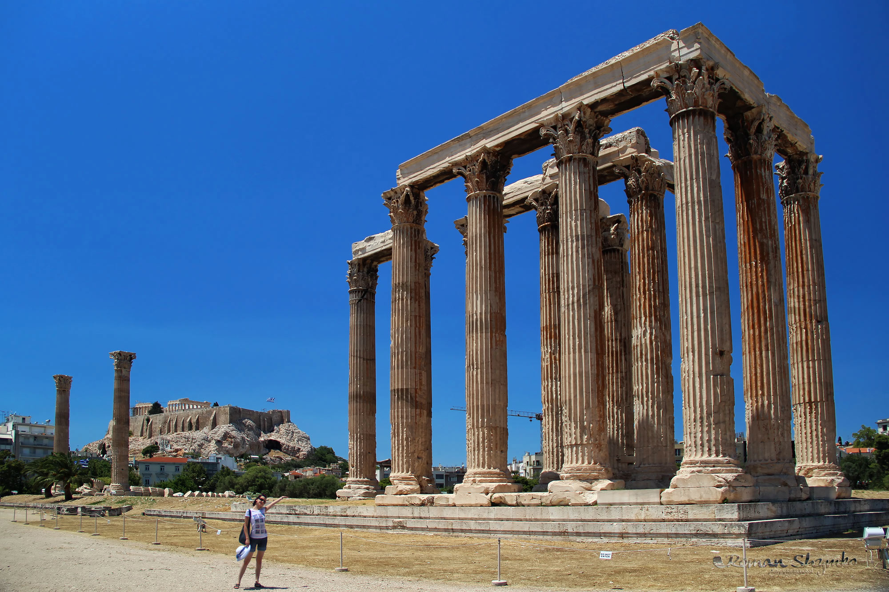
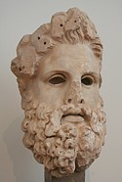
The Olympeion: Temple of Zeus

Slide 19
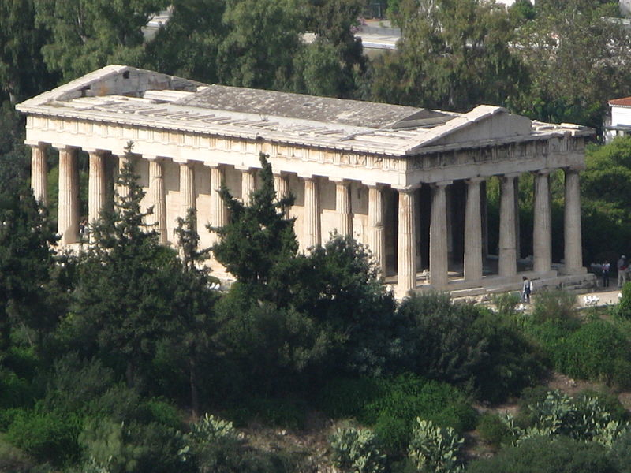
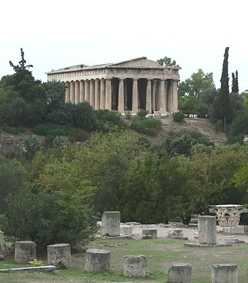
Temple of Hephaestus

Slide 20
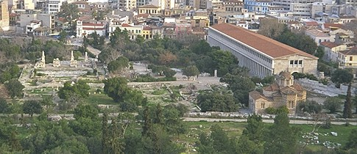
The Agora
Athens Commercial & Civic Center

Slide 21
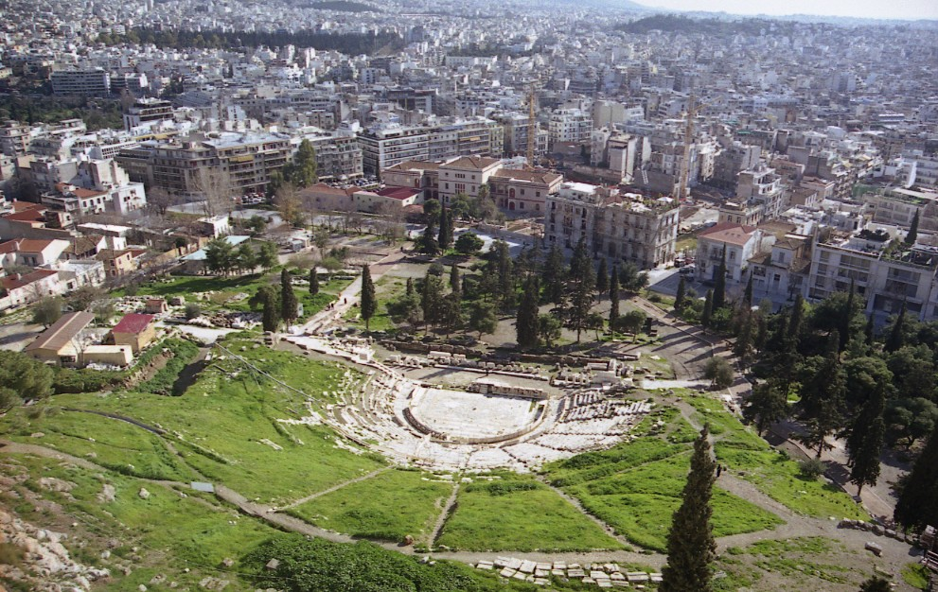
Theater of Dionysus

Slide 22
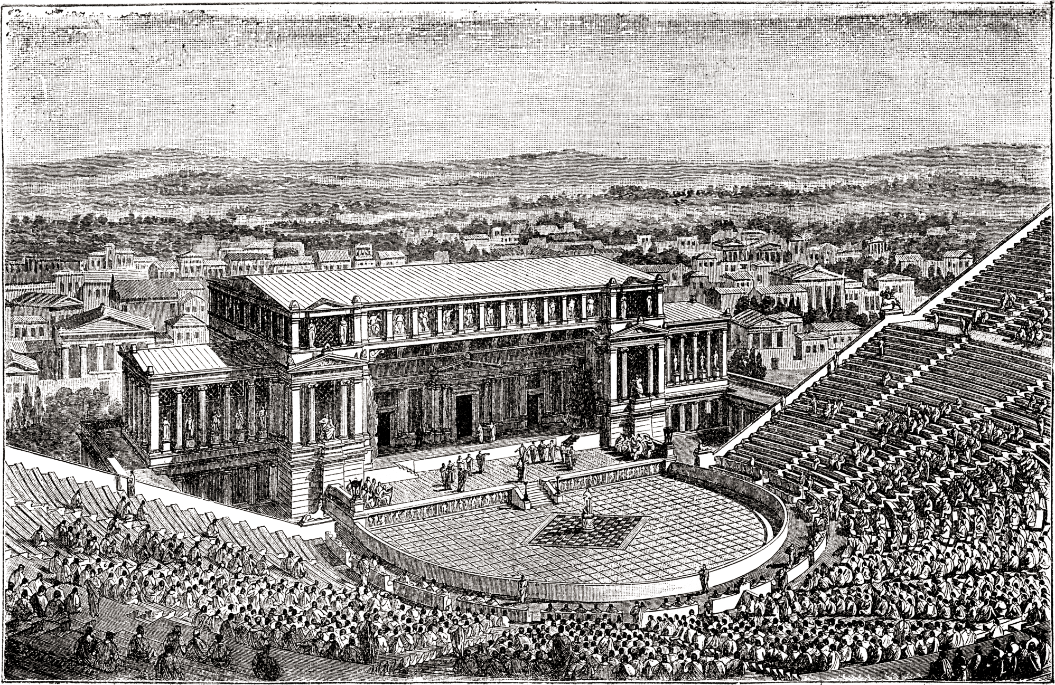
Theater of Dionysus

Slide 23
Acts 17:16
Now while Paul was waiting for them at Athens, his spirit was being provoked [parōxuneto] within him as he was observing the city full of idols.

Slide 24
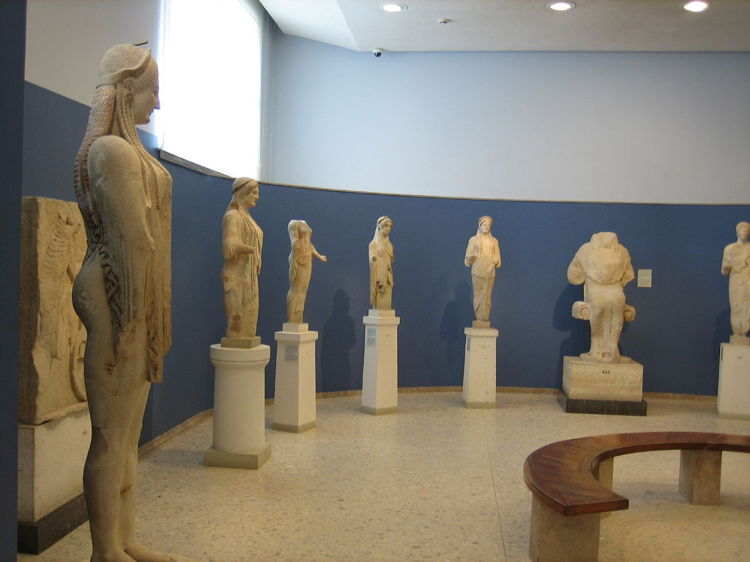
It was claimed that it was easier to find an idol in Athens than to find a man.

Slide 25
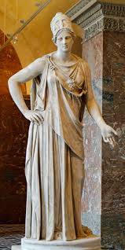
The goddess Athena

Slide 26
Acts 17
17 So he was reasoning in the synagogue with the Jews and the God-fearing Gentiles, and in the market place every day with those who happened to be present. 18 And also some of the Epicurean and Stoic philosophers were conversing with him. Some were saying, “What would this idle babbler wish to say?” Others, “He seems to be a proclaimer of strange deities,”—because he was preaching Jesus and the resurrection.

Slide 27
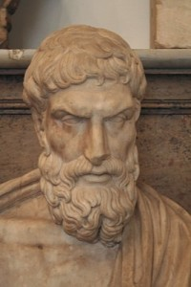
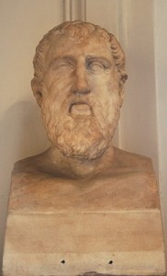
Athens Philosophers:
Epicurus & Zeno

Slide 28
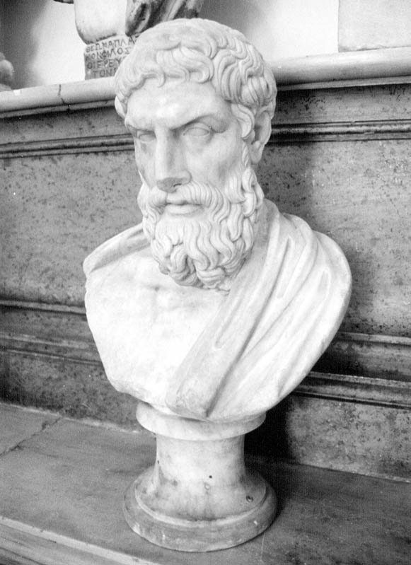
Epicurus of Sámos
(341-270 BCE)
The Greek
“garden philosopher”

Slide 29
“Show wisdom. Strain the wine: and since life is brief, cut short far-reaching hopes! Even while we speak, envious time has sped. Reap the harvest of today putting as little trust as may be in the morrow.”
“carpa dieum”
Epicurus

Slide 30
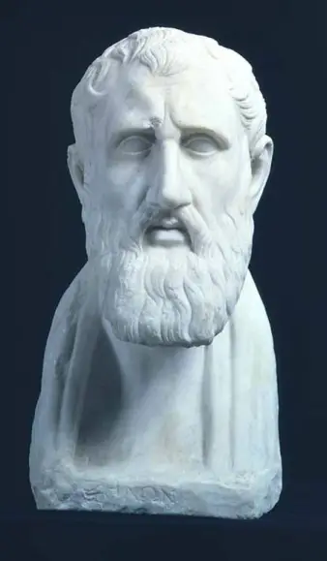
Zeno of Citium
(335-263 BCE)
Commonly referred to as
“The Phonenician”

Slide 31
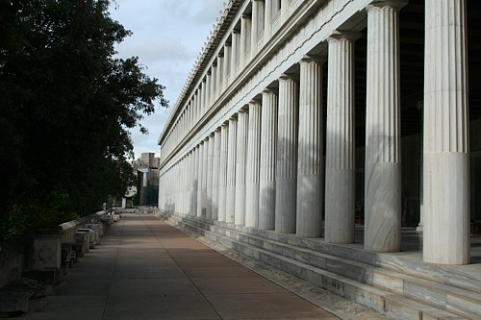
Zeno was poor so he taught as he walked through the Stoa.
His pupils were called “Stoics” because Zeno taught in the Stoa Poikile
Stoa of Attalus

Slide 32
“We have two ears and one mouth, so we should listen more than we say.”
“Man conquers the world by conquering himself.”
Zeno the Stoic

Slide 33
He taught that God was in everything and in every individual. Therefore all men were brothers.
The Stoics lived a high moral life.
Zeno the Stoic

Slide 34
“The purpose of life is happiness, which is achieved by virtue, living according to the dictates of reason, ethical and philosophical training, self-reflection, careful judgements, and inner calm.”
Zeno the Stoic

Slide 35
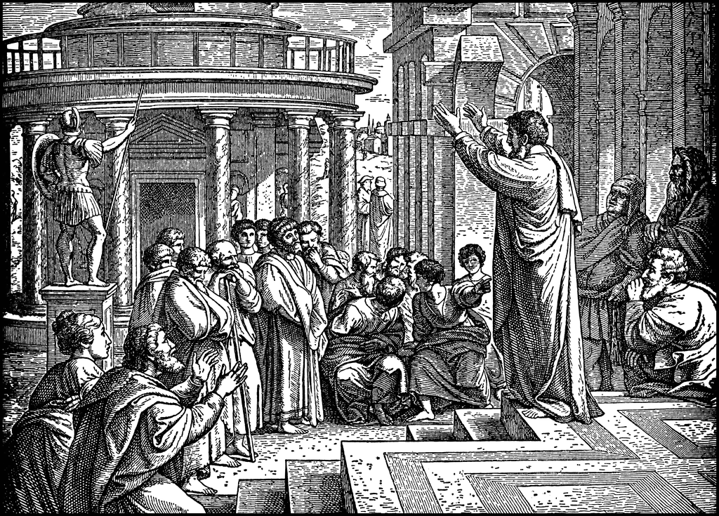
“What would this idle babbler wish to say?”
Idle Babbler = “seed picker”

Slide 36
Acts 17:18b
“Others [were saying], ‘He seems to be a proclaimer of strange deities,’—because he was preaching Jesus and the resurrection.”
Socrates was accused of preaching ‘strange deities’
drank the hemlock cup; buried in Athens

Slide 37
Paul Taught:
The resurrection of Jesus as a type of resurrection of humanity
Socrates & Plato Taught:
That man had an immoral soul and that the soul was released from the prison house of the body by death

Slide 38
The Accusation:
Paul was preaching “strange deities”
Why did they think that?
Jesus & Resurrection (“anastasias”)
They confused the word anastasias with another deity.
Their gods often came in pairs: Jove & Juno; Venus & Adonis; Isis & Osiris; Baal & Astarte: a male and a female god.

Slide 39
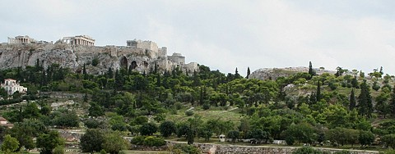
Acts
17:19-20
“And they took him and brought him to the Areopagus, saying, ‘May we know what this new teaching is which you are proclaiming? For you are bringing some strange things to our ears; so we want to know what these things mean.’”

Slide 40
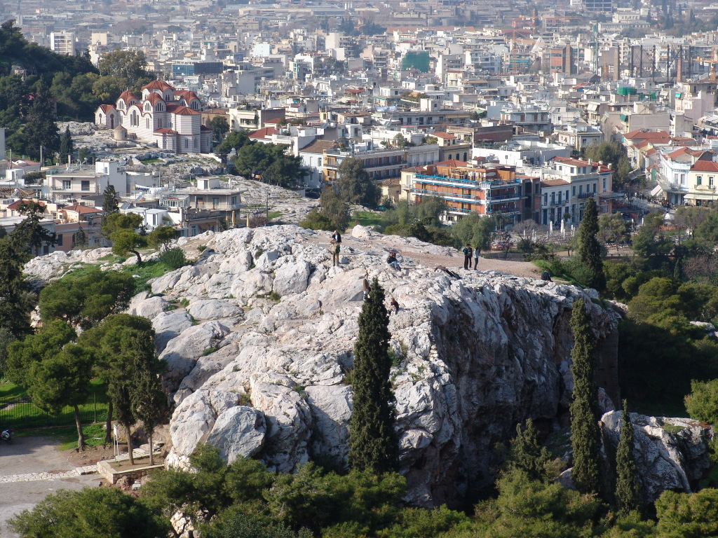
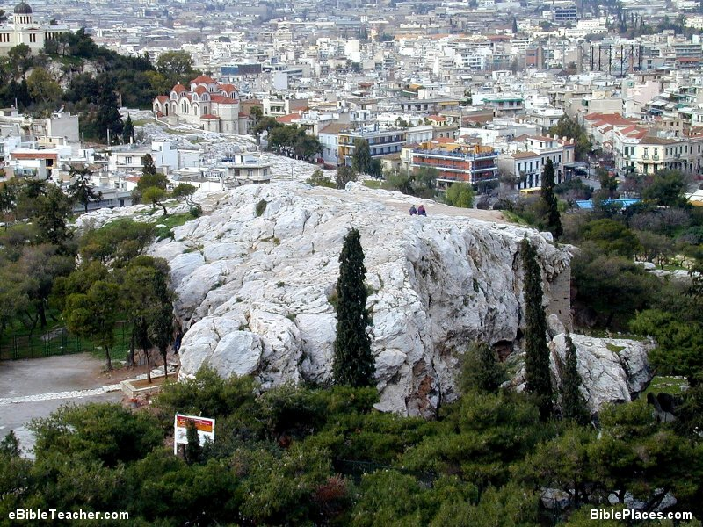
Mars Hill
The Areopagus
spermalogos,

Slide 41
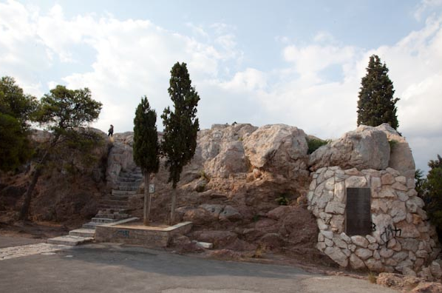
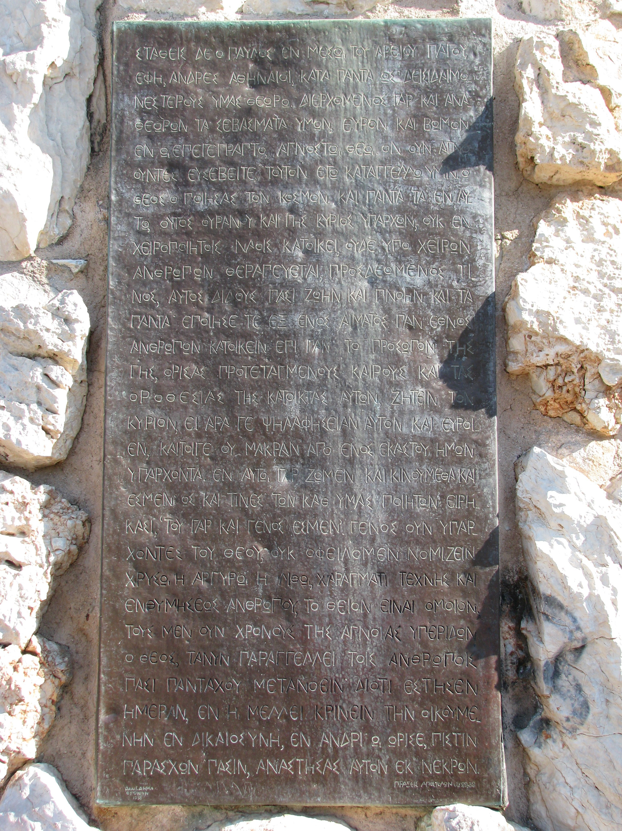
Paul’s teaching inscribed

Slide 42
Acts
17:21
“(Now all the Athenians and the strangers visiting there used to spend their time in nothing other than telling or hearing something new.)”

Slide 43
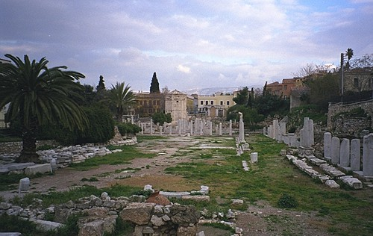
“You go about the market place asking, ‘Is there any news?’”
Demosthenes

Slide 44
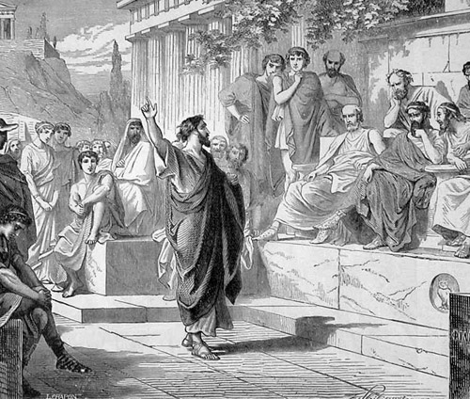
Acts 17:22a
“So Paul stood in the midst of the Areopagus and said, …”
Paul preaching at Mars Hill

Slide 45
“Ye men of Athens, I perceive that in all things ye are too superstitious.”
Acts 17:22b (KJV)
δεισιδαιμονεστερους
NIV = ”in every way you are very religious”
NASB = “you are very religious in all respects”
NLT = “you are very religious in every way”

Slide 46
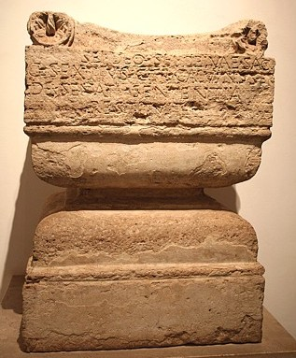
Acts 17:23
“For while I was passing through and examining the objects of your worship, I also found an altar with this inscription, ‘TO AN UNKNOWN GOD.’ Therefore, what you worship in ignorance, this I proclaim to you.’”
Altar to the Unknown God
Found in Rome

Slide 47
Over 3,000 different “gods” honored in Athens
Sacrifices to all their gods did not stop a plague!

Slide 48
The Heart of Paul’s Sermon
Acts 17:24-28

Slide 49
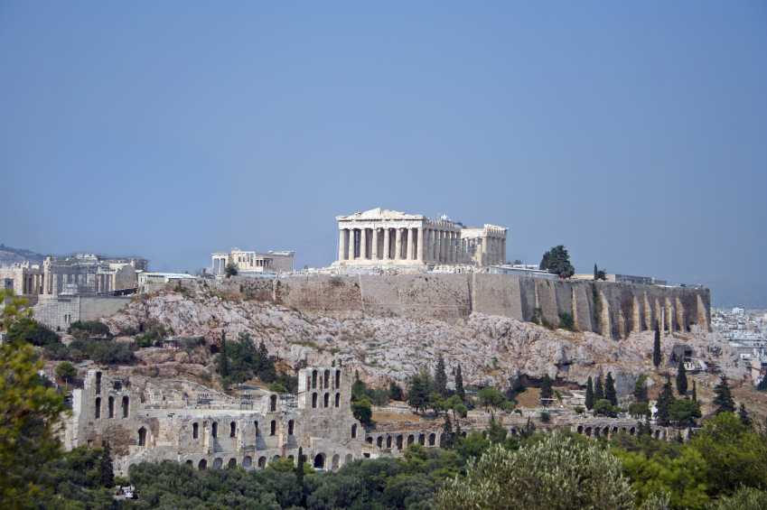
“The God who made the world and all things in it… does not dwell in temples made with hands.” Acts 17:24

Slide 50
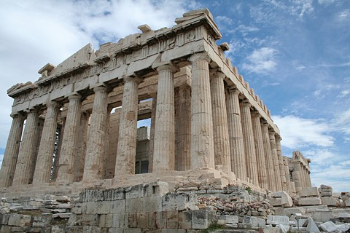
Parthenon: Temple of Athena

Slide 51
Acts 17:28
“ ‘As even some of your own poets have said, For we also are His children.’ ”
Athenian Poet(s)
The Sicilian Poet Aretas

Slide 52
Acts 17:29
“‘Being then the children of God, we ought not to think that the Divine Nature is like gold or silver or stone, an image formed by the art and thought of man.’”

Slide 53
Acts 17:30
“ ‘Therefore, having overlooked the times of ignorance, God is now declaring to men that all people everywhere should repent.’”

Slide 54
Acts 17:31
“ ‘because He has fixed a day in which He will judge the world in righteousness through a Man whom He has appointed, having furnished proof to all men by raising Him from the dead.’”

Slide 55
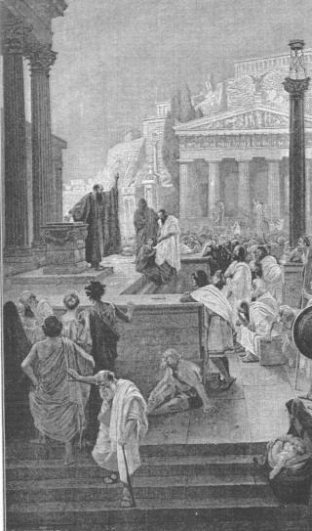
New Concepts
Repentance
Resurrection
Judgement—Jesus “will judge the world”
(Plato’s teaching challenged)
Paul Preaching
by Gebhard Fugel

Slide 56
Acts 17:32
“Now when they heard of the resurrection of the dead, some began to sneer, but others said, ‘We shall hear you again concerning this.’”

Slide 57
“Death, the king of terrors, is nothing to us, because as long as we exist, death is not present, and when death comes, we are no more.”
Epicurus
“some sneered”

Slide 58
The Stoics were not as offended as the Epicureans.
Stoics would say, “We would like to hear you again on this matter.”
Stoics more open

Slide 59
Acts 17:33-34
“So Paul went out of their midst. But some men joined him and believed, among whom also were Dionysius the Areopagite and a woman named Damaris and others with them.”

Slide 60
Acts 17:34
“… some men joined him and believed”
Dionysius the Areopagite
A woman named Damaris
Others with them

Slide 61
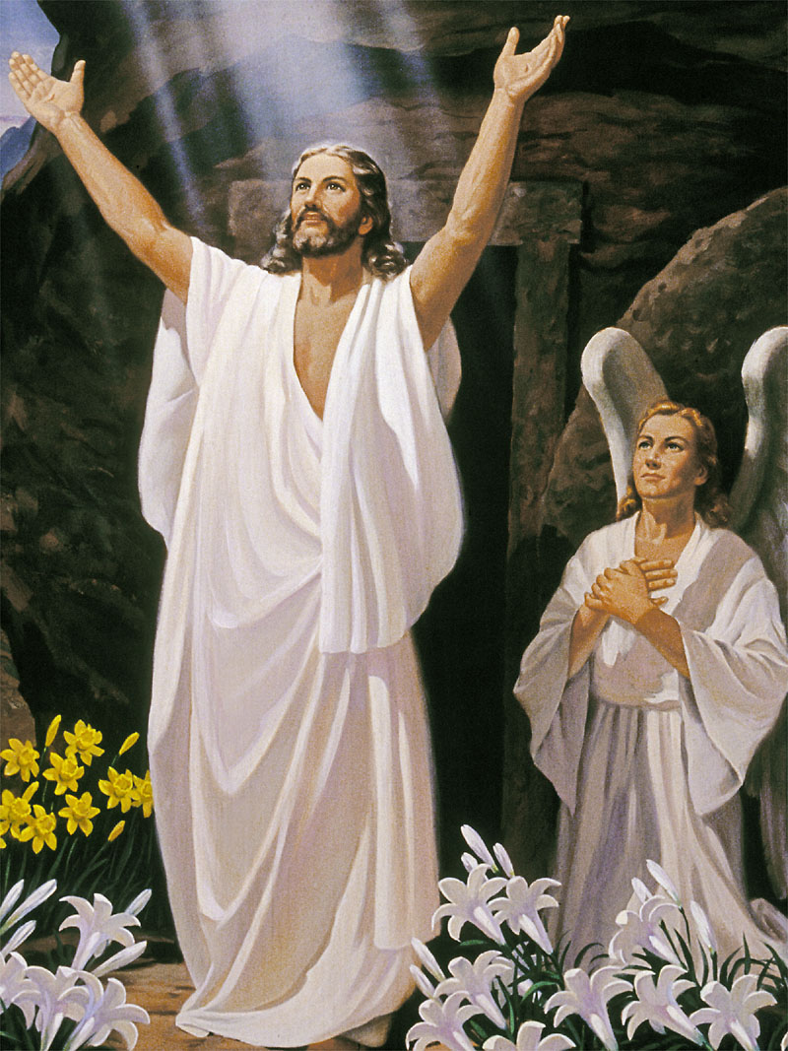
We Too Must Choose!
“The UNknown God”
“The KNOWN God”

Slide 62
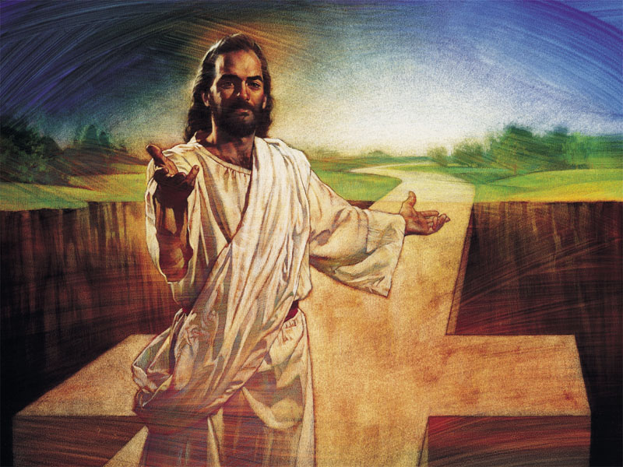

Slide 63
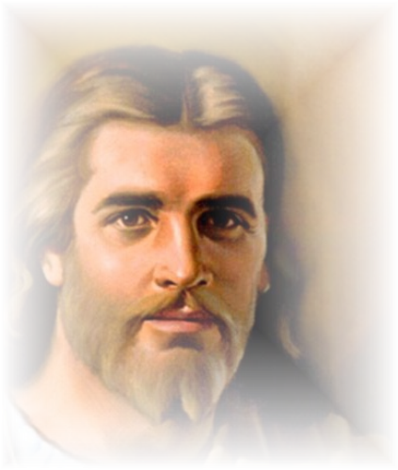
1
More About Jesus
Hymn 245
More about Jesus I would know,
More of His grace to others show;
More of His saving fullness see,
More of His love who died for me.
More, more about Jesus,
More, more about Jesus;
More of His saving fullness see,
More of His love who died for me.

Slide 64
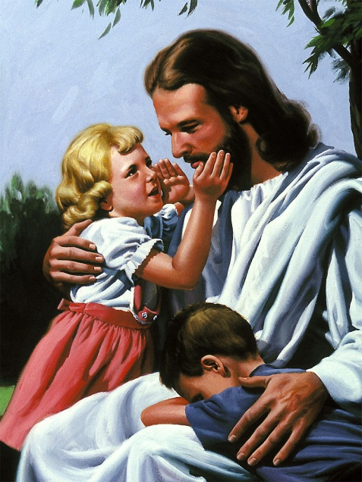
2
More About Jesus
Hymn 245
More about Jesus let me learn,
More of His holy will discern;
Spirit of God, my teacher be,
Showing the things of Christ to me.
More, more about Jesus,
More, more about Jesus;
More of His saving fullness see,
More of His love who died for me.

Slide 65
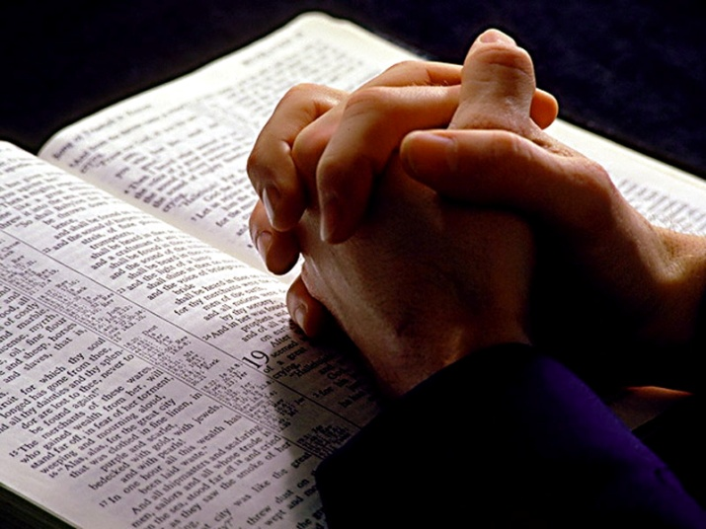
3
More About Jesus
Hymn 245
More about Jesus; in His word,
Holding communion with my Lord,
Hearing His voice in every line,
Making each faithful saying mine.
More, more about Jesus,
More, more about Jesus;
More of His saving fullness see,
More of His love who died for me.

Slide 66
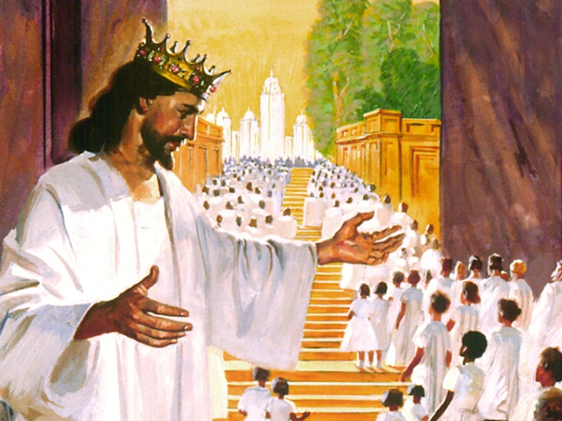
4
More About Jesus
Hymn 245
More about Jesus; on His throne,
Riches in glory all His own;
More of His kingdom’s sure increase;
More of His coming, Prince of Peace.
More, more about Jesus,
More, more about Jesus;
More of His saving fullness see,
More of His love who died for me.

Slide 67
Benediction
“The grace of the Lord Jesus Christ, and the love of God, and the fellowship of the Holy Spirit, be with you all.”
2 Corinthians 13:14

Slide 68
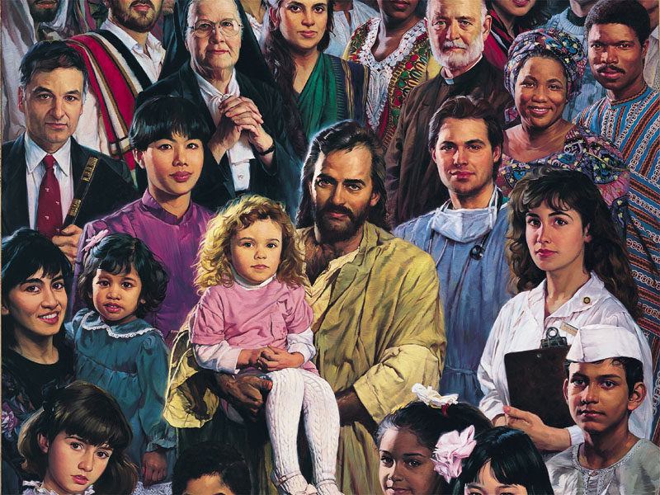

Slide 70
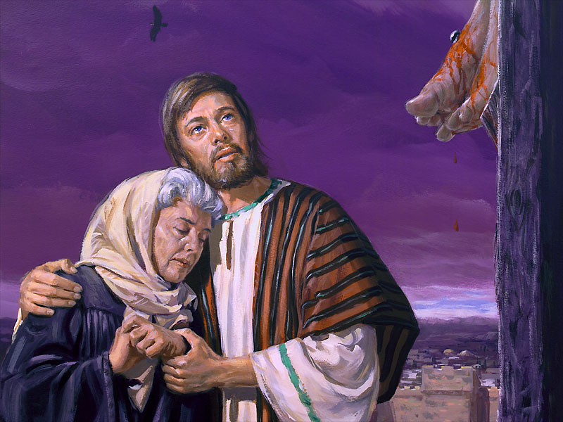
My Jesus, I Love Thee
Hymn 321
My Jesus, I love Thee, I know Thou art mine;
For Thee all the follies of sin I resign.
My gracious Redeemer, my Savior art Thou;
If ever I loved Thee, my Jesus, ’tis now.

Slide 71
My Jesus, I Love Thee
2nd stanza)
I love Thee because Thou has first loved me,
And purchased my pardon on Calvary’s tree.
I love Thee for wearing the thorns on Thy brow;
If ever I loved Thee, my Jesus, ’tis now.

Slide 72
My Jesus, I Love Thee
3rd stanza
I’ll love Thee in life, I will love Thee in death,
And praise Thee as long as Thou lendest me breath;
And say when the death dew lies cold on my brow,
If ever I loved Thee, my Jesus, ’tis now.

Slide 73
My Jesus, I Love Thee
4th stanza
In mansions of glory and endless delight,
I’ll ever adore Thee in heaven so bright;
I’ll sing with the glittering crown on my brow;
If ever I loved Thee, my Jesus, ’tis now.

Slide 74
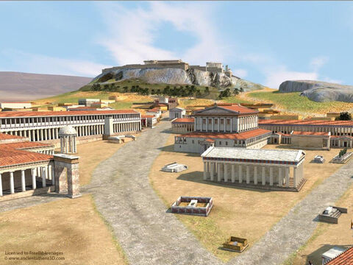

Slide 75
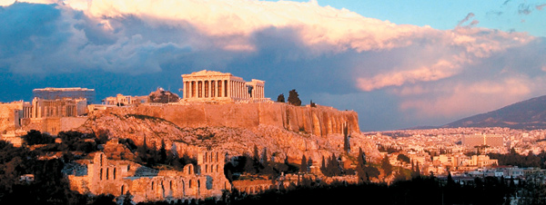
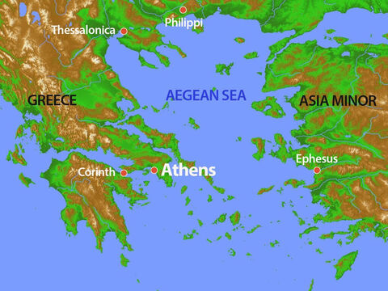

Slide 78
The Parthenon and Erechtheum are the most prominent buildings

Slide 83
Posidon
Apollo
Aphrodite
Traditional Deities

