Slide 1
Amnesty
This Photo by Unknown author is licensed under CC BY-NC-ND.

Slide 2
And I saw another angel fly in the midst of heaven, having the everlasting gospel to preach unto them that dwell on the earth, and to every nation, and kindred, and tongue, and people, Saying with a loud voice, Fear God, and give glory to him; for the hour of his judgment is come: and worship him that made heaven, and earth, and the sea, and the fountains of waters.
Rev 14:6-7

Slide 3
A Three Part Gospel
-The danger of a partial Gospel- without all the “Good News” it’s not good news at all, but a real problem!
The blood of Jesus is central to all three aspects of the Gospel!- In this first part it is the shed blood of Christ that brings peace!

Slide 4
Amnesty (LOST!)
“But side by side with the principal that should pervade the history of Christianity was found another that should preside over its doctrine. This was the great idea of Christianity- the idea of Grace, of pardon, of Amnesty, the gift of eternal life. This idea supposed in man an alienation from God, and an inability of returning...

Slide 5
by any power of his own [whether the initiation or execution of that returning] into communion with that infinitely Holy Being… further, salvation considered as coming, [even partly] from man, is the creative principal of every error and abuse.”

Slide 6
regards doctrine, human systems had taught that salvation is of man: the religions of the earth had devised an earthly salvation. They had told men that heaven would be given them as a reward: they had fixed a price; and what a price!...

Slide 7
The religion of God taught that salvation comes from Him alone; that it is a gift from heaven; that it emanates from an amnesty- from the grace of the sovereign ruler: “God hath given to us eternal life” (1John 5:11)” J.H. Mmerle D’Abigne
“History of the Reformation of the 16th Century”

Slide 8
Drifting Away
For God in all his fullness was pleased to live in Christ, and through him God reconciled everything to himself. He made peace with everything in heaven and on earth by means of Christ’s blood on the cross. This includes you who were once far away from God. You were his enemies, separated from him by your evil thoughts and actions.
This Photo by Unknown author is licensed under CC BY-NC-ND.

Slide 9
Yet now he has reconciled you to himself through the death of Christ in his physical body. As a result, he has brought you into his own presence, and you are holy and blameless as you stand before him without a single fault.
But you must continue to believe this truth and stand firmly in it. Don’t drift away from the assurance you received when you heard the Good News.
Col 1:19-23 NLT

Slide 10
The Assurance of Peace!
Romans Chapters 1-3
For the wrath of God is revealed from heaven against all ungodliness and unrighteousness of men, who hold the truth in unrighteousness; Because that which may be known of God is manifest in them; for God hath shewed it unto them...

Slide 11
...For the invisible things of him from the creation of the world are clearly seen, being understood by the things that are made, even his eternal power and Godhead; so that they are without excuse: Because that, when they knew God, they glorified him not as God, neither were thankful; but became vain in their imaginations, and their foolish heart was darkened...

Slide 12
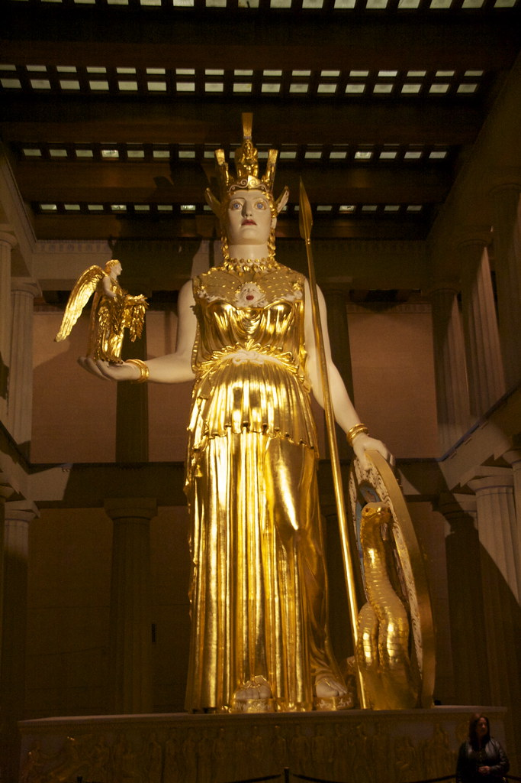
...Professing themselves to be wise, they became fools, And changed the glory of the uncorruptible God into an image made like to corruptible man, and to birds, and fourfooted beasts, and creeping things...
This Photo by Unknown author is licensed under CC BY.

Slide 13
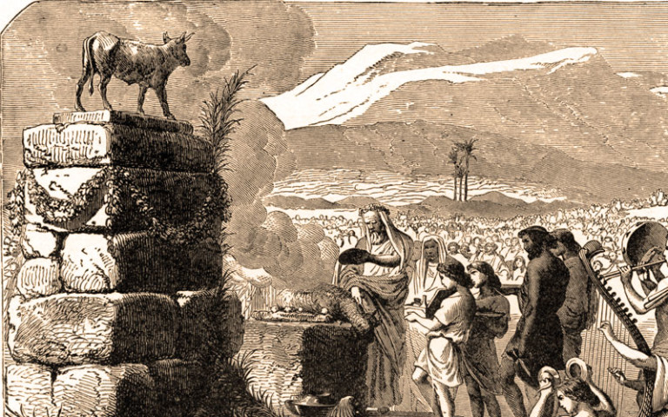
...Wherefore God also gave them up to uncleanness through the lusts of their own hearts, to dishonour their own bodies between themselves: Who changed the truth of God into a lie, and worshipped and served the creature more than the Creator, who is blessed for ever. Amen...
This Photo by Unknown author is licensed under CC BY-SA-NC.

Slide 14
...For this cause God gave them up unto vile affections: for even their women did change the natural use into that which is against nature: And likewise also the men, leaving the natural use of the woman, burned in their lust one toward another; men with men working that which is unseemly, and receiving in themselves that recompence of their error which was meet...

Slide 15
...And even as they did not like to retain God in their knowledge, God gave them over to a reprobate mind, to do those things which are not convenient; Being filled with all unrighteousness, fornication, wickedness, covetousness, maliciousness; full of envy, murder, debate, deceit, malignity; whisperers,...

Slide 16
...Backbiters, haters of God, despiteful, proud, boasters, inventors of evil things, disobedient to parents, Without understanding, covenantbreakers, without natural affection, implacable, unmerciful: Who knowing the judgment of God, that they which commit such things are worthy of death, not only do the same, but have pleasure in them that do them.
Romans 1:18-32

Slide 17
Nasty Folks?.. Well Yes, But…
Romans 2:1-3 NLT
You may think you can condemn such people, but you are just as bad, and you have no excuse! When you say they are wicked and should be punished, you are condemning yourself, for you who judge others do these very same things.

Slide 18
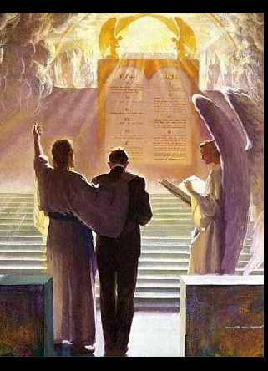
And we know that God, in his justice, will punish anyone who does such things. Since you judge others for doing these things, why do you think you can avoid God’s judgment when you do the same things?
This Photo by Unknown author is licensed under CC BY-NC-ND.

Slide 19
Romans 2:17-24
Behold, thou art called a Jew, and rest in the law, and make thy boast of God, And know his will, and approve the things that are more excellent, being instructed out of the law; And art confident that thou thyself art a guide of the blind, a light of them which are in darkness,

Slide 20
An instructor of the foolish, a teacher of babes, which hast the form of knowledge and of the truth in the law. Thou therefore which teach another, teach thou not thyself? Thou that preach a man should not steal, dost thou steal?

Slide 21
Thou that say a man should not commit adultery, dost thou commit adultery? thou that abhor idols, dost thou commit sacrilege? Thou that make thy boast of the law, through breaking the law dishonourest God? For the name of God is blasphemed among the Gentiles through you, as it is written.

Slide 22
Question;
How many times do we hear “Christians” charged with hypocrisy? Why is that? Because almost all Christians think they are better than the “Sinners” in the world!
We Slander the Gospel when we represent this idea to the world… None of us is better than any other…
This Photo by Unknown author is licensed under CC BY-SA.

Slide 23
Romans 3:9-19
“What then? are we better than they? No, in no wise: for we have before proved both Jews and Gentiles, that they are all under sin;

Slide 24
As it is written, There is none righteous, no, not one:
There is none that understandeth, there is none that seeketh after God.
They are all gone out of the way, they are together become unprofitable; there is none that doeth good, no, not one.
Their throat is an open sepulchre; with their tongues they have used deceit; the poison of asps is under their lips:

Slide 25
Their feet are swift to shed blood:
Destruction and misery are in their ways:
And the way of peace have they not known:
There is no fear of God before their eyes.
This Photo by Unknown author is licensed under CC BY-SA-NC.

Slide 26
Now we know that what things soever the law saith, it saith to them who are under the law: that every mouth may be stopped, and all the world may become guilty before God.
Therefore by the deeds of the law there shall no flesh be justified in his sight: for by the law is the knowledge of sin.”

Slide 27
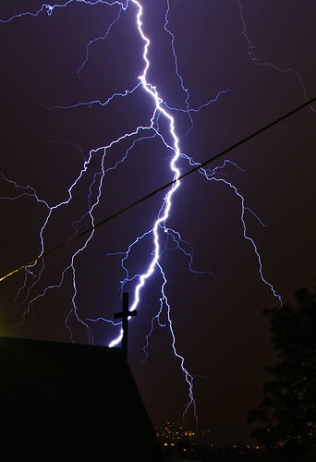
The Law was not given so that we might, by keeping it faithfully, find favor with God and thus avert or appease His wrath
This Photo by Unknown author is licensed under CC BY-NC-ND.

Slide 28
Question?
Then how does Man Find Peace With God and Escape His Just Wrath?

Slide 29
Faithfulness!
Romans 3:
“But now the righteousness of God without the law is manifested, being witnessed by the law and the prophets; Even the righteousness of God which is by faith [Faithfulness] of Jesus Christ unto all and upon all them that believe: for there is no difference:
This Photo by Unknown author is licensed under CC BY-NC-ND.

Slide 30
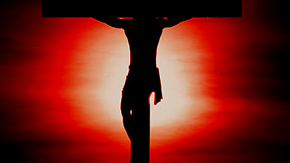
For all have sinned, and come short of the glory of God; Being justified freely by his grace through the redemption that is in Christ Jesus: Whom God hath set forth to be a propitiation [appeasement of wrath] through [the] faith[fulness] in his blood, to declare his righteousness for the remission of sins that are past, through the forbearance of God;...
This Photo by Unknown author is licensed under CC BY-NC-ND.

Slide 31
To declare, I say, at this time his righteousness: that he might be just, and the justifier of him which believeth in Jesus...

Slide 32
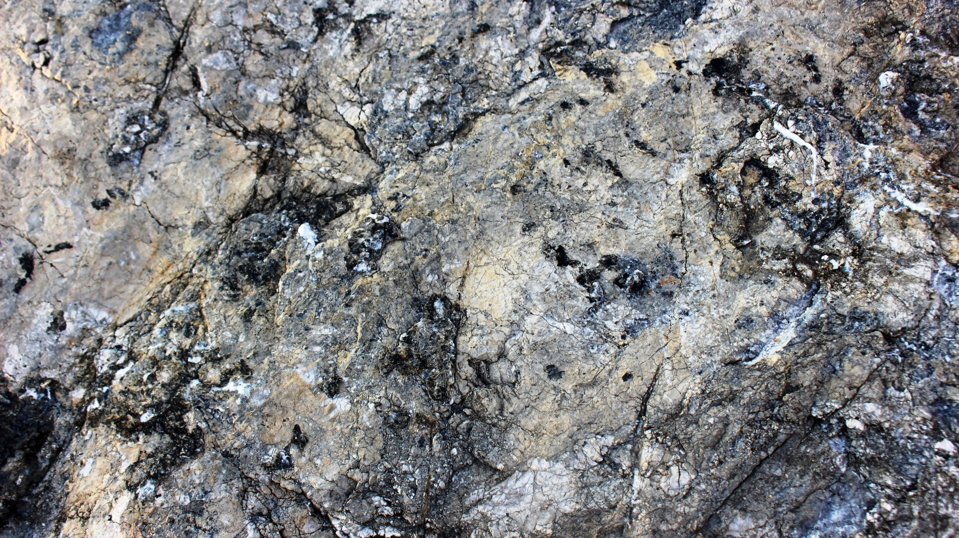
Do we then make void the law through faith[Faithfulness]? God forbid: yea, we establish the law. “

Slide 33
The Message of Amnesty is the first part of the gospel, and the spring from which the other two parts flow.

Slide 34
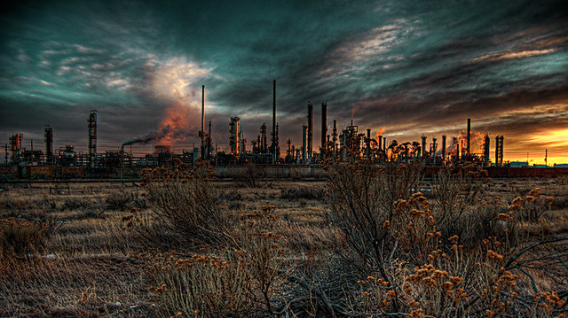
The World and the Church must hear a message, the offer of peace with God; the Amnesty which He has provided to ALL must be presented to a dying church and world.
This Photo by Unknown author is licensed under CC BY-NC-ND.

Slide 35
From this “Good News” the other two parts of the Gospel will be embraced and result in the salvation of anyone, (Christian or non- Christian) no matter who they are or what they have done!!

Slide 36
Next week part 2 of the Everlasting Gospel

